Slide 1
RM1D
Checking over Your Completed Circuit Board Before Testing!

Slide 2
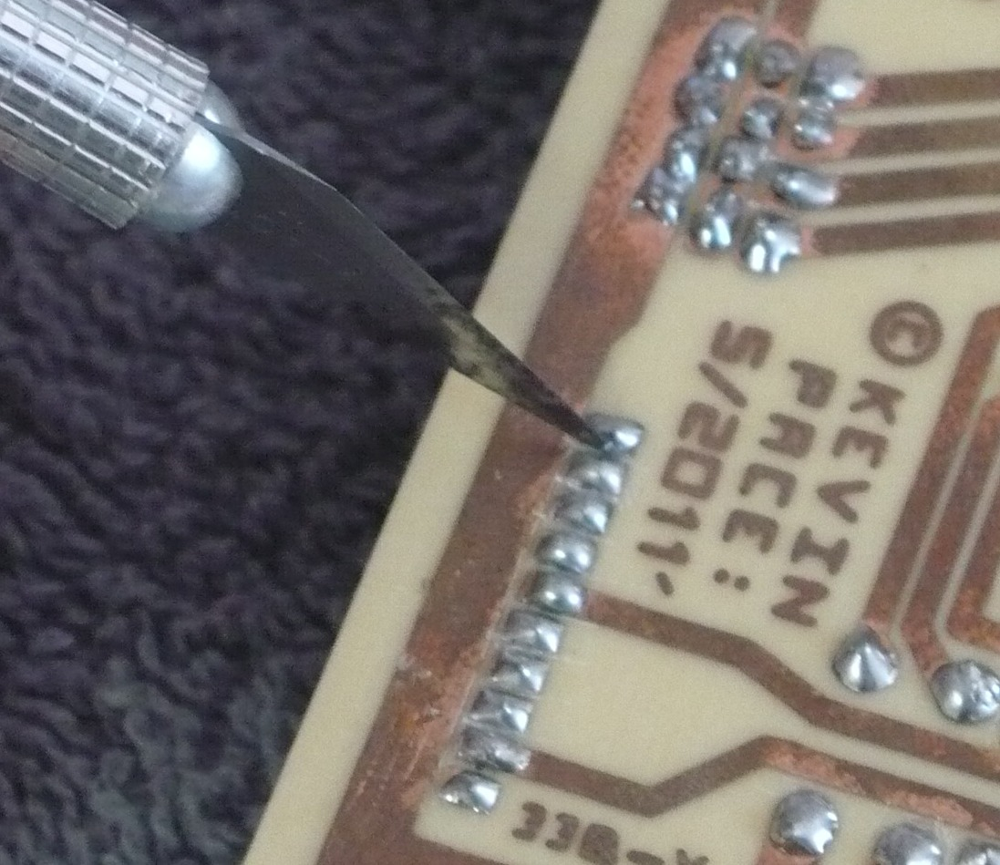
Scoring between Soldered pins with x-acto knife
The back side of an X-acto blade works great for scraping between solder joints. Check over YOUR board carefully and use the knife to score between any areas of copper and solder that SHOULD NOT be connected! Even the slightest bridge of solder can cause a short circuit and damage the board.

Slide 3
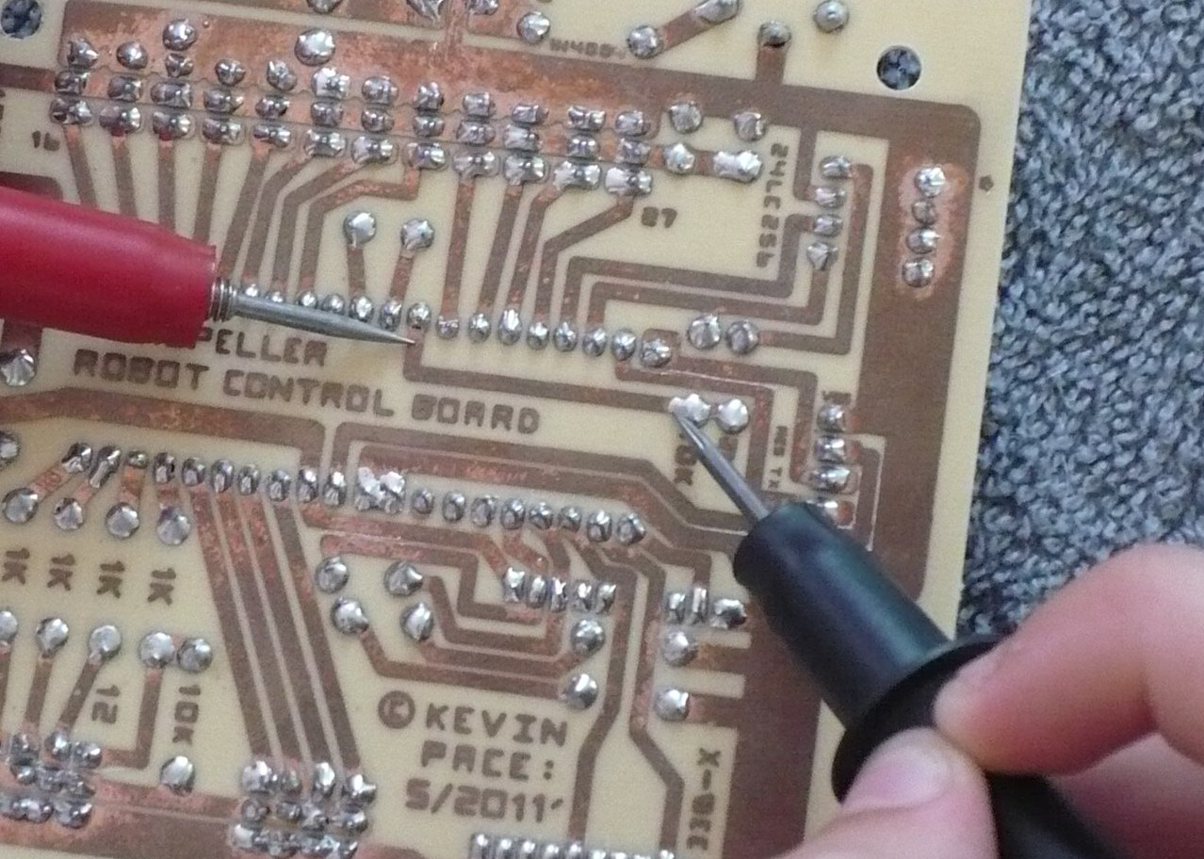
When your soldering is complete and you have scored between any bridged areas its time to use a multimeter to check all your copper lines to be sure they have “Continuity”.
Continuity testing bridged areas such as POWER and ground
Visually follow any lines of copper that should be connected and place one probe of the meter on one end of the copper trace and the other probe on the other end of the trace. (as seen in the photograph)
Check the next slide for further examples.

Slide 4
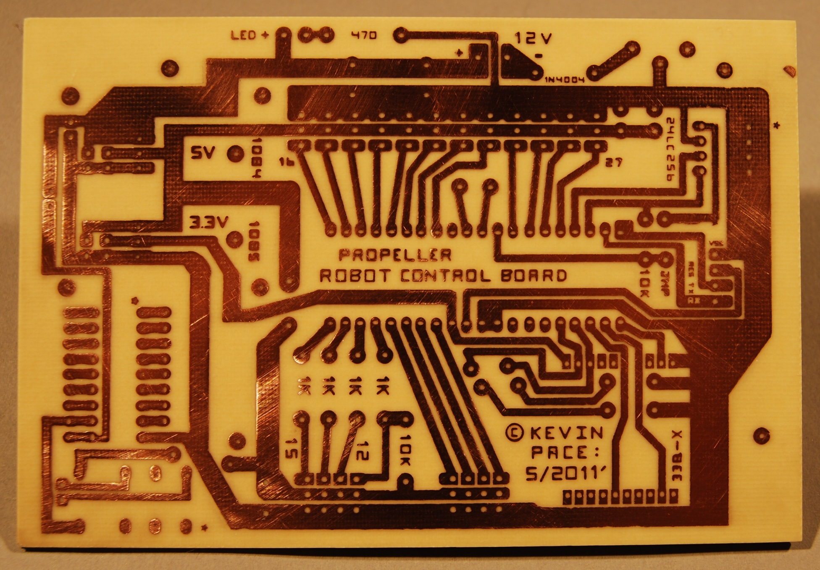
A few examples of how to do the continuity test are shown below. Just keep in mind that any line of connected copper can be checked at each end!
To here
From here
Or from here
To here

Slide 5
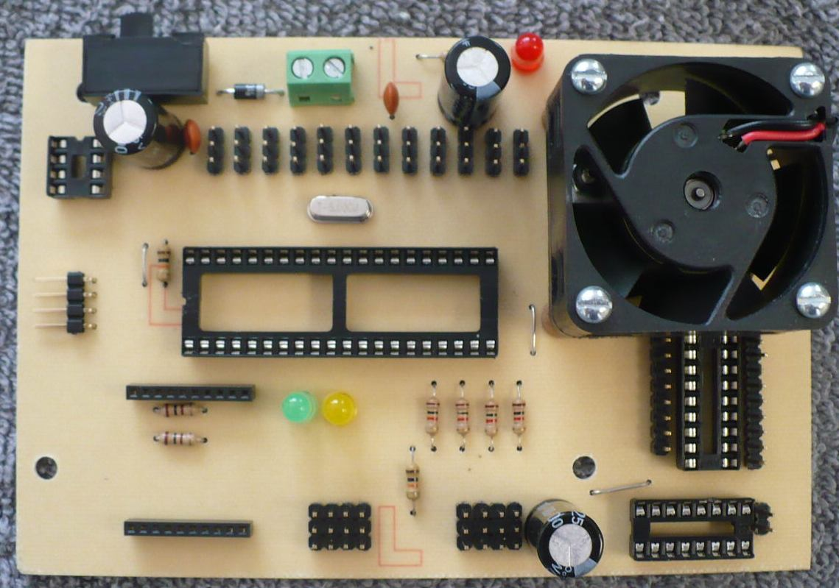
NOW is the BEST time to look over YOUR board carefully to see if ALL of your parts are mounted in the correct place and have the correct polarity. Pay close attention to DETAILS such as the resistor color bands and the stripes on the Electrolytic Capacitors.

